Slide 1
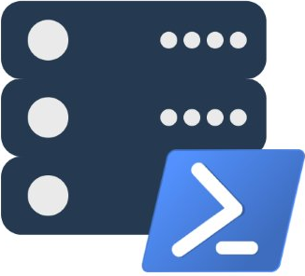
dbatools ❤ SQL Server
Presented by
Chrissy LeMaire, MVP
chrissy lemaire, mvp: netnerds.net, @cl code: dbatools.io

Slide 2

Cloud & DataCenter (PowerShell)
2015, 2016
chrissy lemaire, mvp: netnerds.net, @cl code: dbatools.io

Slide 3

DBA at NATO Special Ops
chrissy lemaire, mvp: netnerds.net, @cl code: dbatools.io

Slide 4

twitter
@cl
chrissy lemaire, mvp: netnerds.net, @cl code: dbatools.io
Notes:
Community project, initially started out as Start-SqlMigration but has grown into a DBA’s best friend. dbatools currently sports 79 commands.
How many of you have heard of dbatools? How many of you have used it? How many knew it was born in Belgium? :D

Slide 5

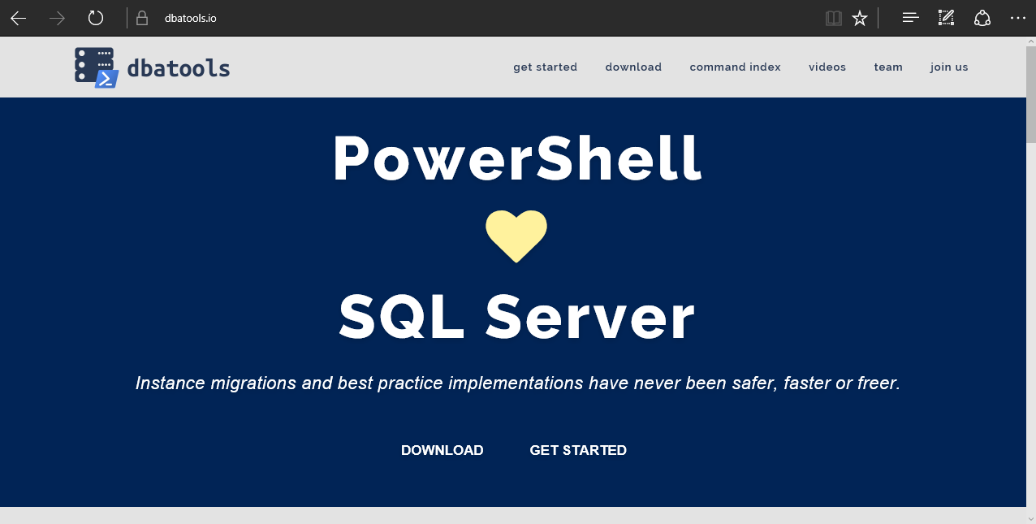
dbatools
chrissy lemaire, mvp: netnerds.net, @cl code: dbatools.io
Notes:
Community project, initially started out as Start-SqlMigration but has grown into a DBA’s best friend. dbatools currently sports 79 commands.
How many of you have heard of dbatools? How many of you have used it? How many knew it was born in Belgium? :D

Slide 6
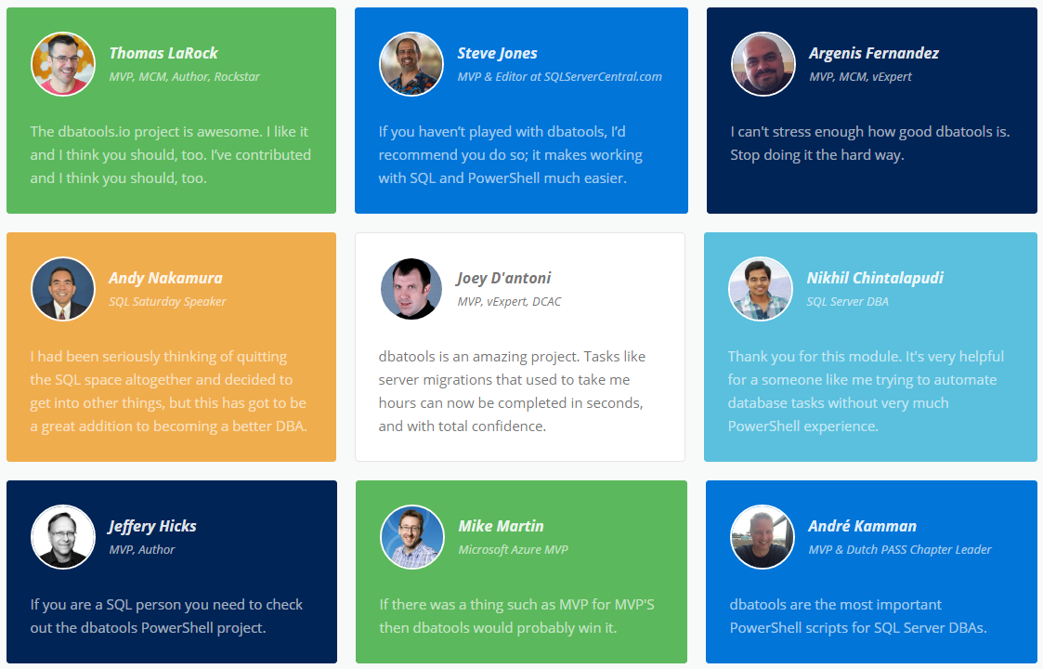
community ❤ dbatools
chrissy lemaire, mvp: netnerds.net, @cl code: dbatools.io
Notes:
Community project, initially started out as Start-SqlMigration but has grown into a DBA’s best friend. dbatools currently sports 79 commands.
How many of you have heard of dbatools? How many of you have used it? How many knew it was born in Belgium? :D

Slide 7
Install
PowerShell Gallery
Install-Module dbatools
Other Ways
dbatools.io/download
chrissy lemaire, mvp: netnerds.net, @cl code: dbatools.io
Notes:
Gallery requires admin access and is built into PowerShell v5. Other versions also support it with a bit of configuration.
Download
Unzip
Import-Module

Slide 8
Support
SQL Server 2000 – vNext
Express – Enterprise Edition
Clustered and stand-alone instances
Windows and SQL authentication
Default and named instances
Multiple instances on one server
chrissy lemaire, mvp: netnerds.net, @cl code: dbatools.io

Slide 9
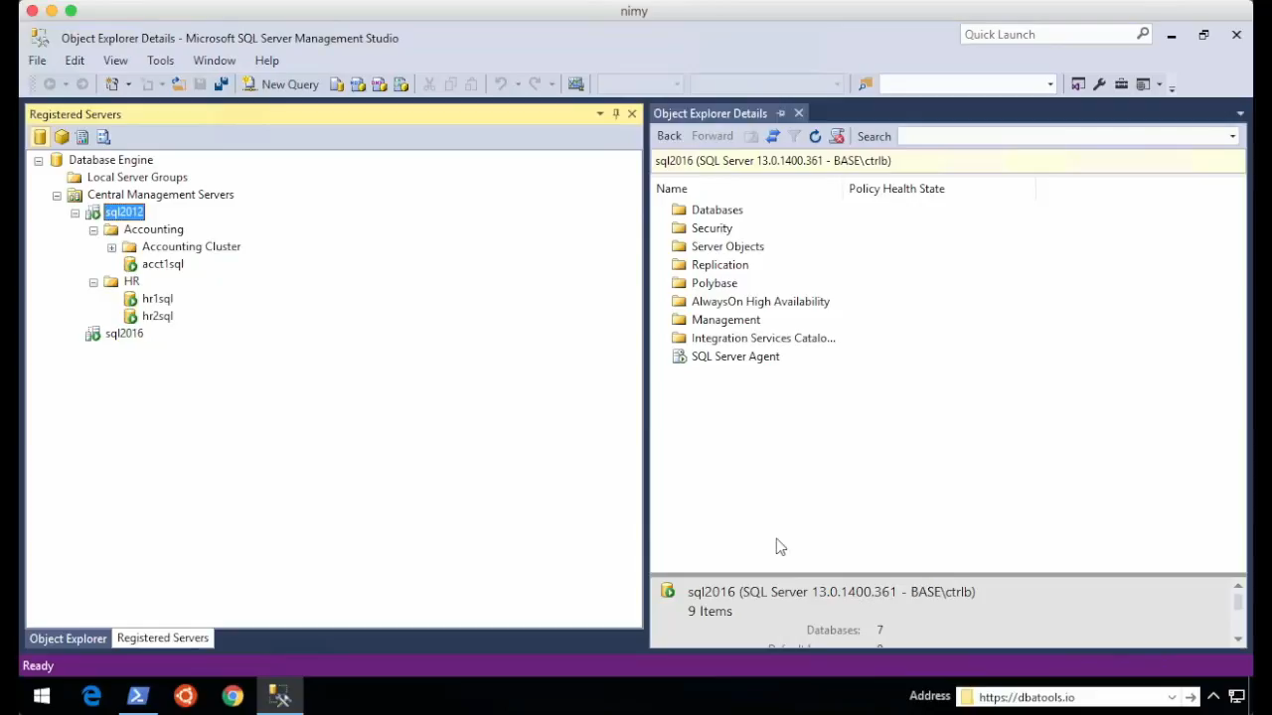
Start-SqlMigration
chrissy lemaire, mvp: netnerds.net, @cl code: dbatools.io

Slide 10
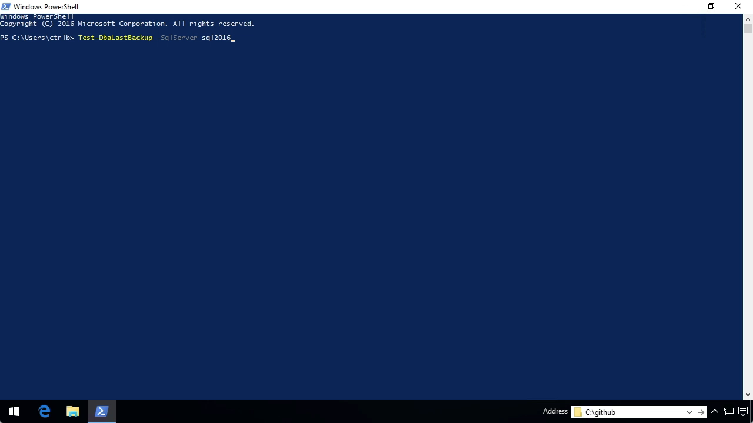
Test-DbaLastBackup
chrissy lemaire, mvp: netnerds.net, @cl code: dbatools.io

Slide 11
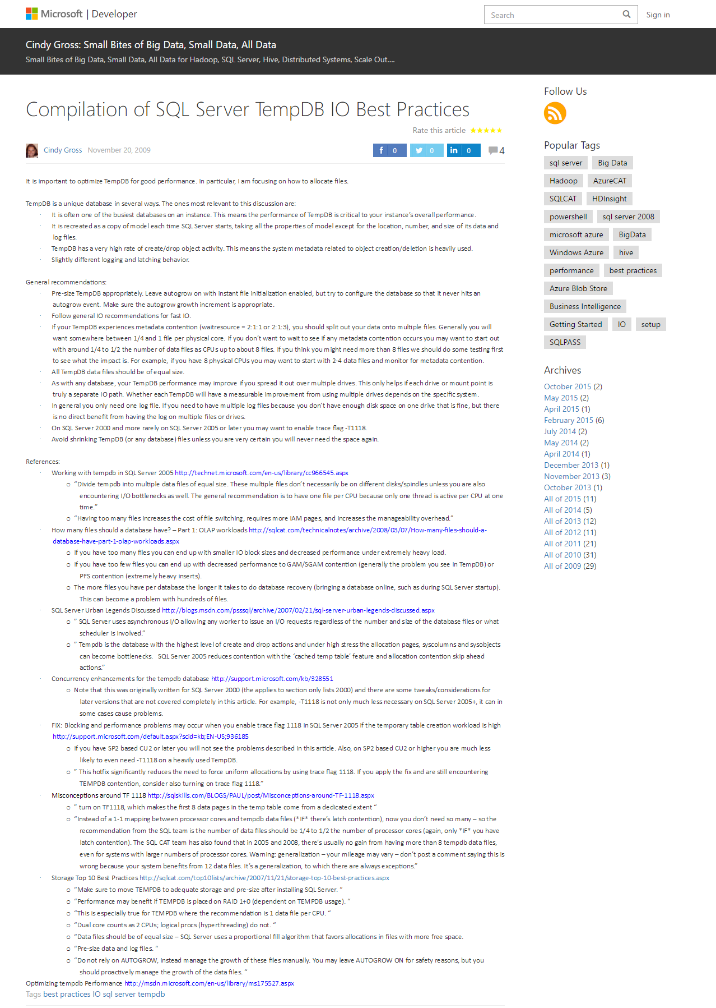
TempDb Configuration
chrissy lemaire, mvp: netnerds.net, @cl code: dbatools.io

Slide 12
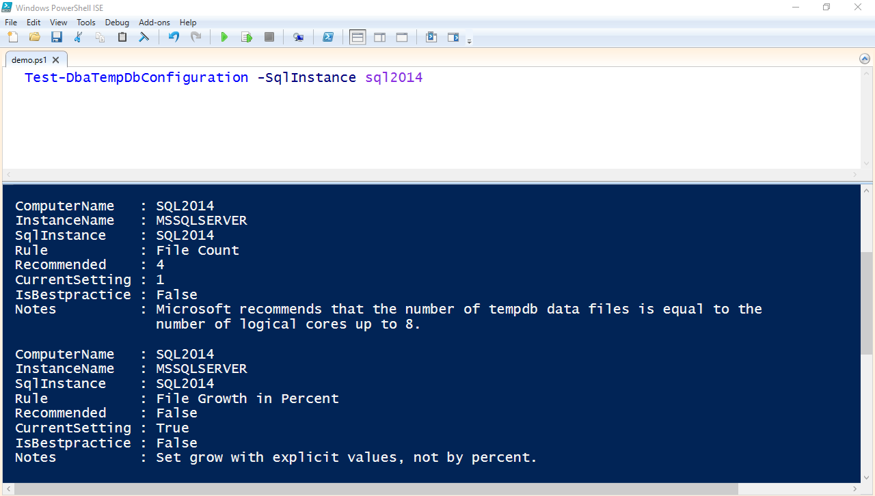
Test-DbaTempDbConfiguration
chrissy lemaire, mvp: netnerds.net, @cl code: dbatools.io

Slide 13
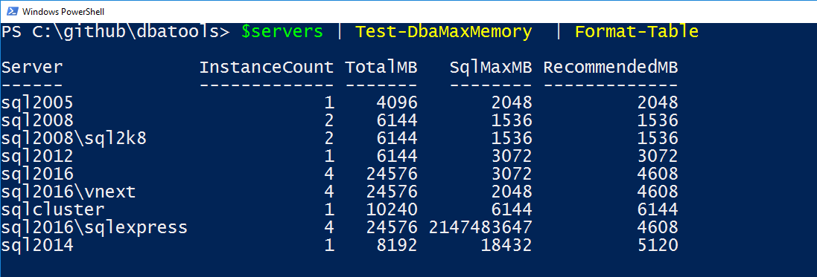
Test-DbaMaxMemory | Set-DbaMaxMemory
chrissy lemaire, mvp: netnerds.net, @cl code: dbatools.io

Slide 14
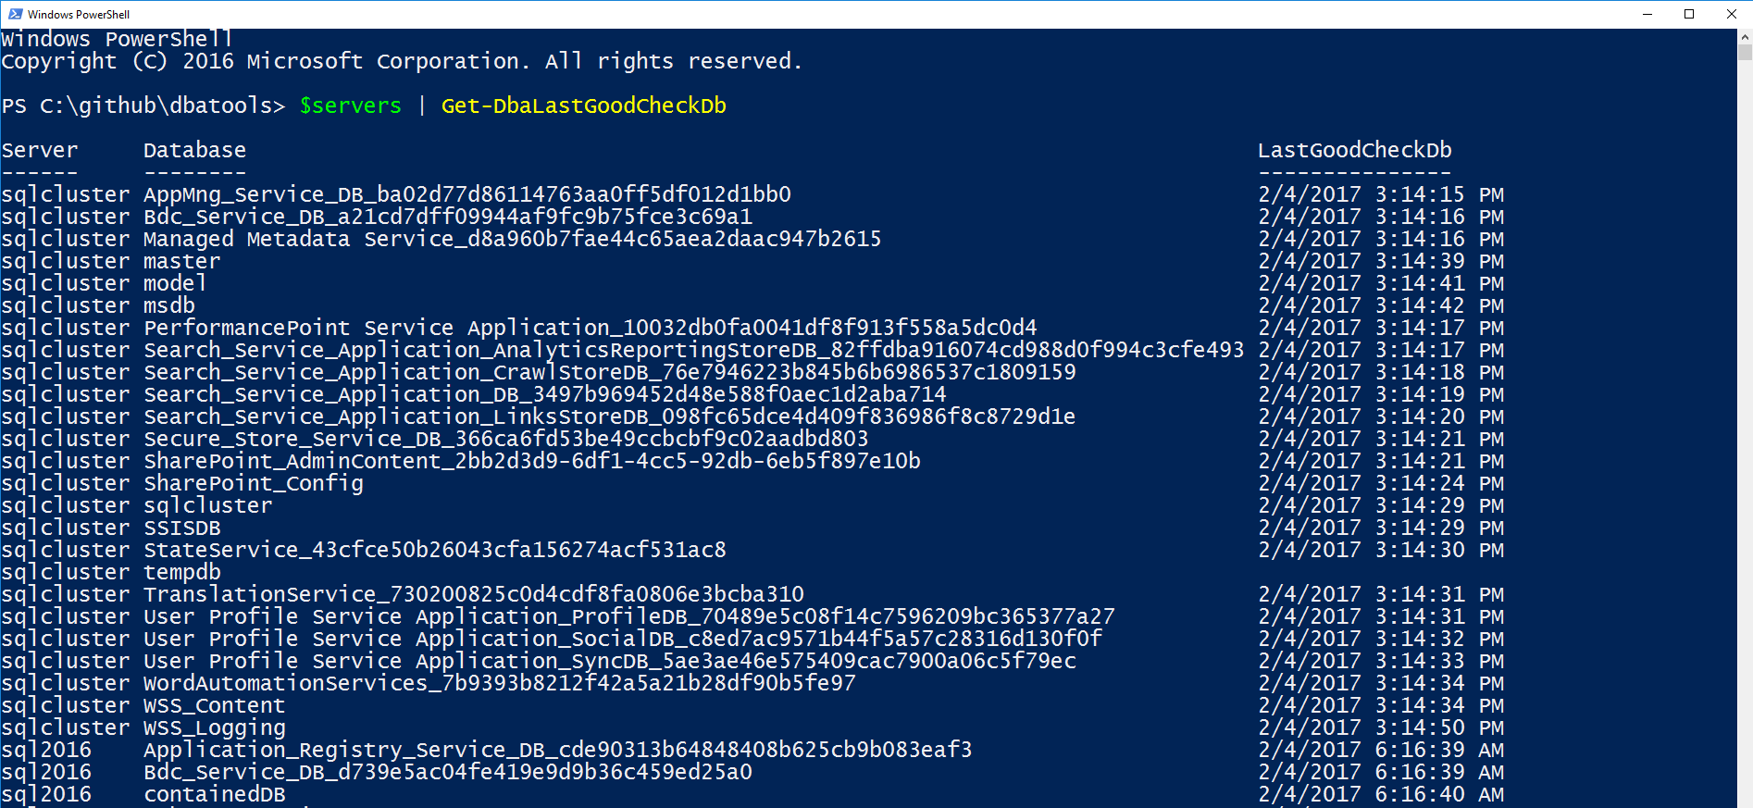
Get-DbaLastGoodCheckDb
chrissy lemaire, mvp: netnerds.net, @cl code: dbatools.io

Slide 15
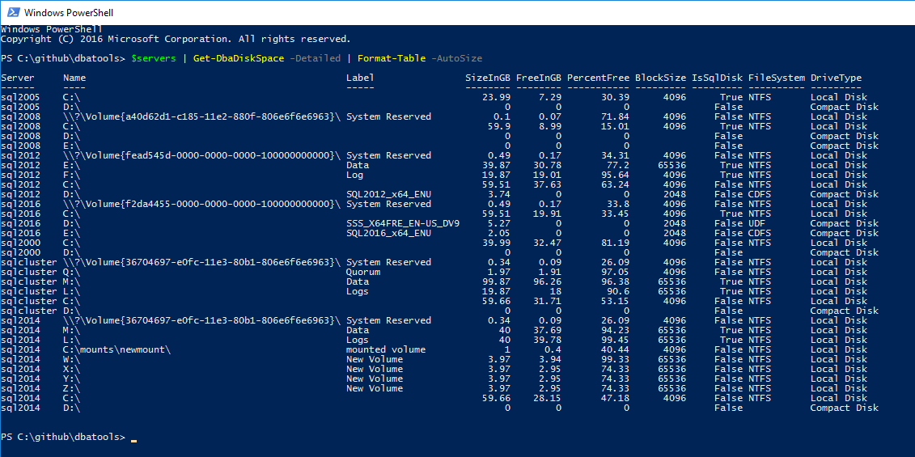
Get-DbaDiskSpace – BlockSize & IsSqlDisk
chrissy lemaire, mvp: netnerds.net, @cl code: dbatools.io

Slide 16
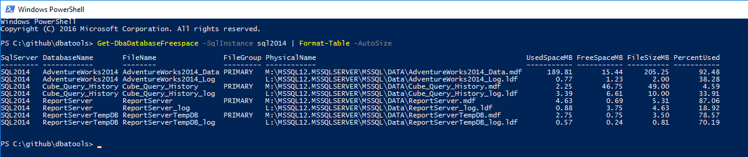
Get-DbaDatabaseFreespace
chrissy lemaire, mvp: netnerds.net, @cl code: dbatools.io

Slide 17
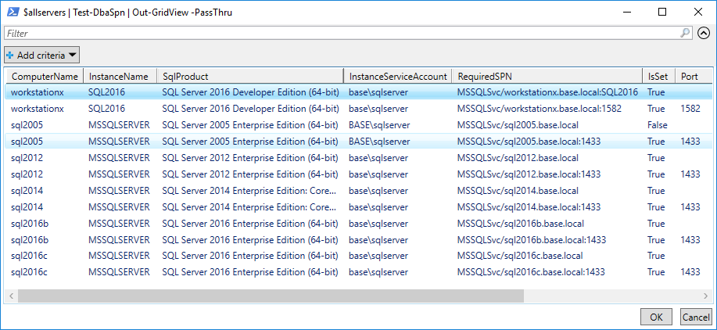
Test-DbaSpn | Set-DbaSpn
chrissy lemaire, mvp: netnerds.net, @cl code: dbatools.io

Slide 18
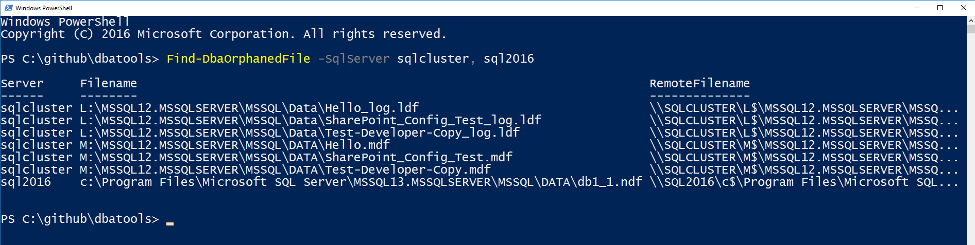
Find-DbaOrphanedFile
chrissy lemaire, mvp: netnerds.net, @cl code: dbatools.io

Slide 19
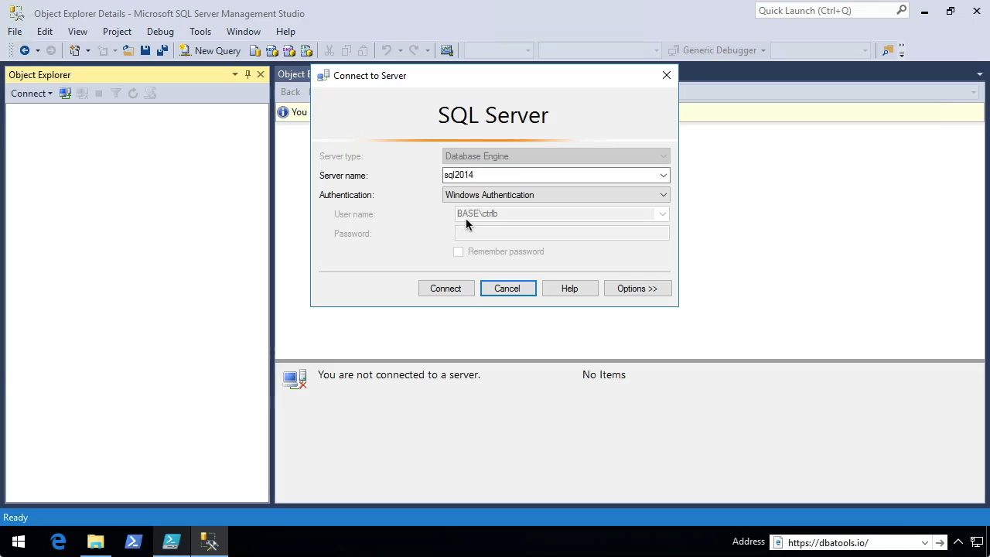
Reset-SqlAdmin
chrissy lemaire, mvp: netnerds.net, @cl code: dbatools.io

Slide 20
How to Get-Help
Extensive documentation within each command Get-Help Start-SqlMigration –Detailed
Extensive documentation on dbatools.io
dbatools.io/Start-SqlMigration
dbatools.io/Repair-SqlOrphanUser
Some commands have videos
dbatools.io/youtube
chrissy lemaire, mvp: netnerds.net, @cl code: dbatools.io
Notes:
If you’re wondering – how do I find out more?

Slide 21
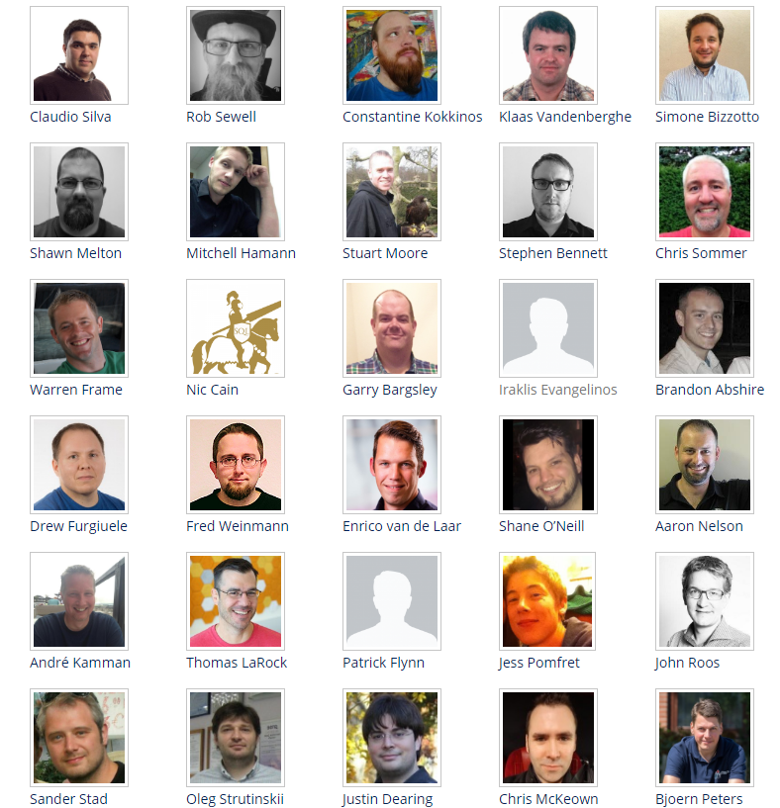
Major Contributors
❤
chrissy lemaire, mvp: netnerds.net, @cl code: dbatools.io

Slide 22
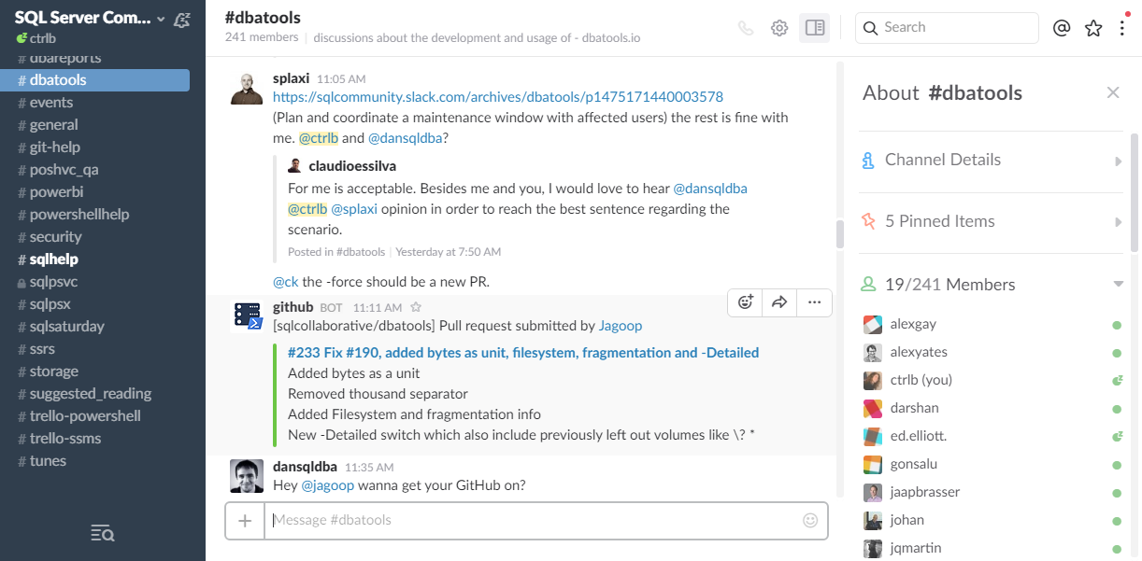
Join us! - dbatools.io/slack
chrissy lemaire, mvp: netnerds.net, @cl code: dbatools.io

